Slide 1
Advanced Data Centric Web Applications
Bachelor of Science (Honours) in Computing in Software Development
Bachelor of Science in Computing in Software
Development
Department of Computer Science & Applied Physics

Slide 2
Spring MVC
The Spring Web MVC framework provides a Model-View-Controller (MVC) architecture that can be used to develop flexible and loosely coupled web applications.
Spring MVC framework is designed around a DispatcherServlet, that dispatches requests to handlers.
The MVC pattern separates the application into the following concerns:
Model
View
Controller

Slide 3
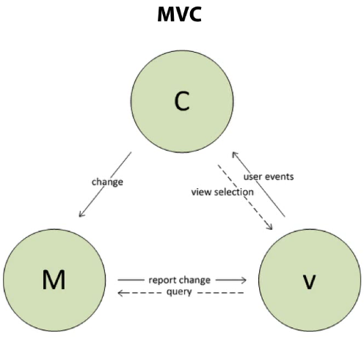
Spring MVC

Slide 4
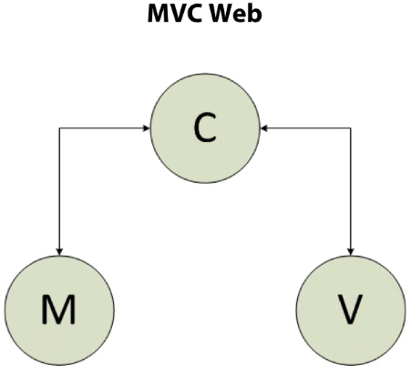
Spring MVC

Slide 5
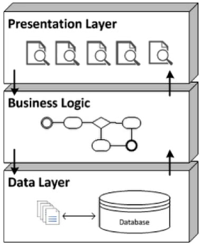
N-Tier Architecture

Slide 6
Spring MVC Tiers
View
(JSPs)
Controller
(@Controller)
Business Logic
(@Service)
Data Model / Database
(Model Object)

Slide 7



Architecture

Slide 8
Dispatcher Servlet
Spring MVC is request-driven and designed around a central servlet called the DispatcherServlet.
The DispatcherServlet handles all HTTP requests and responses.
It is also integrated with the Spring IoC container and enables use of all other Spring features.

Slide 9
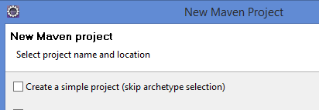
Maven Configuration
Create a new Maven project in Eclipse
This time don’t skip archetype selection:

Slide 10
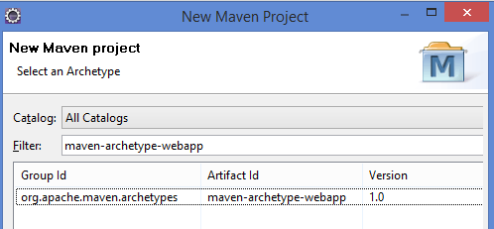
Maven Configuration
Type in maven-archetype-webapp to the Filter and select the artefact with the following Maven coordinates:

Slide 11
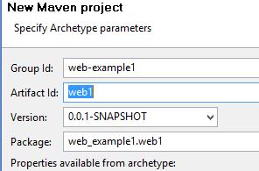
Maven Configuration
Give the Maven project it’s own coordinates and press Finish

Slide 12
Maven Configuration
Add the following dependencies to the pom.xml
<dependency>
<groupId>org.springframework</groupId>
<artifactId>spring-webmvc</artifactId>
<version>4.3.6.RELEASE</version>
</dependency>
<dependency>
<groupId>javax.servlet</groupId>
<artifactId>servlet-api</artifactId>
<version>2.5</version>
<scope>provided</scope>
</dependency>
<dependency>
<groupId>javax.servlet</groupId>
<artifactId>jstl</artifactId>
<version>1.2</version>
<scope>provided</scope>
</dependency>

Slide 13
Maven Configuration
Maven Dependency Scopes
compile
Default scope. Include the dependency in the JAR/WAR file.
provided
Don’t include the dependency in the JAR/WAR file. Usually selected when the dependency will be provided by the runtime container.

Slide 14
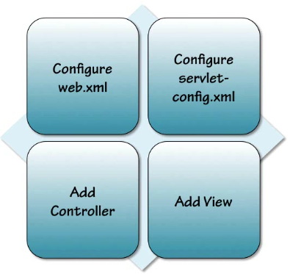
Spring MVC Configuration

Slide 15
Spring MVC Configuration – web.xml
Update the web-app header information:
<web-app xmlns="http://java.sun.com/xml/ns/javaee"
xmlns:xsi="http://www.w3.org/2001/XMLSchema-instance"
xsi:schemaLocation="http://java.sun.com/xml/ns/javaee
http://java.sun.com/xml/ns/javaee/web-app_3_0.xsd"
version="3.0">

Slide 16
Spring MVC Configuration – web.xml
Add new servlet information:
<servlet>
<servlet-name>web1Servlet</servlet-name>
<servlet-class>org.springframework.web.servlet.DispatcherServlet</servlet-class>
<init-param>
<param-name>contextConfigLocation</param-name>
<param-value>/WEB-INF/config/web1-servlet-config.xml</param-value>
</init-param>
</servlet>

Slide 17
Spring MVC Configuration – web.xml
Add servlet mapping:
Name of the servlet we previously defined
<servlet-mapping>
<servlet-name>web1Servlet</servlet-name>
<url-pattern>*.html</url-pattern>
</servlet-mapping>
URI extensions the servlet will accept

Slide 18
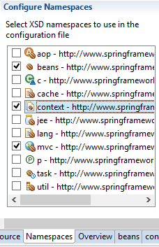
Spring MVC Configuration servlet-config.xml
Create a new Spring Bean Configuration (web1-servlet-config.xml) file in the folder specified in the servlet definition in web.xml.
Add the context and mvc namespaces.

Slide 19
Spring MVC Configuration servlet-config.xml
annotation-driven says we want to use annotations to configure the application
component-scan defines where to look for the annotations
<mvc:annotation-driven/>
<context:component-scan base-package="com.web1.controllers"></context:component-scan>

Slide 20
Spring MVC Configuration servlet-config.xml
InternalResourceViewResolver resolves the user provided URI into the actual URI.
Folder containing the views
<bean class="org.springframework.web.servlet.view.InternalResourceViewResolver">
<property name="prefix" value="/WEB-INF/jsp/"></property>
<property name="suffix" value=".jsp"></property>
</bean>
Suffix for the view files

Slide 21
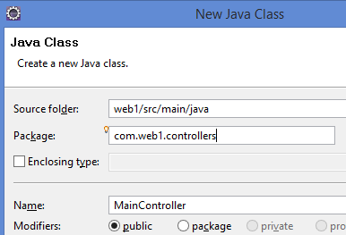
Spring MVC Configuration Controller
Create a new class called MainController in the folder src/main/java and in the package com.web1.controllers

Slide 22
Spring MVC Configuration Controller
package com.web1.controllers;
import org.springframework.stereotype.Controller;
import org.springframework.ui.Model;
import org.springframework.web.bind.annotation.RequestMapping;
@Controller
public class MainController {
@RequestMapping(value = "/hello")
public String helloWorld(Model model) {
model.addAttribute("greeting", "Hello to the World!");
return "helloWorld";
}
}
Marks the POJO as a Controller
Map any url ending in hello.html to the helloWorld method
Model object which can be used in the view
Adding data to the model
JSP page to render

Slide 23
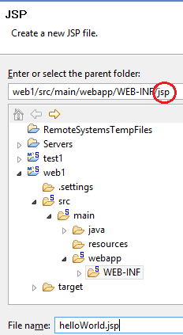
Spring MVC Configuration View
Create a jsp file called helloWorld.jsp as shown:

Slide 24
Spring MVC Configuration View
Update helloWorld.jsp with the following EL command to extract data from the Model:
<body>
<h1>${greeting}</h1>
</body>

Slide 25
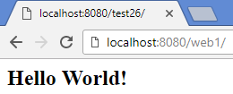
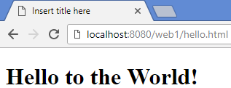
Spring MVC Run The Application
Right click on the root of the project in and select Run As/Run on Server.
Select the Tomcat server and press Finish.
Open a browser and go to the web address (e.g. http://localhost:8080/web1)
Now go to the web address ending in hello.html:

Slide 26
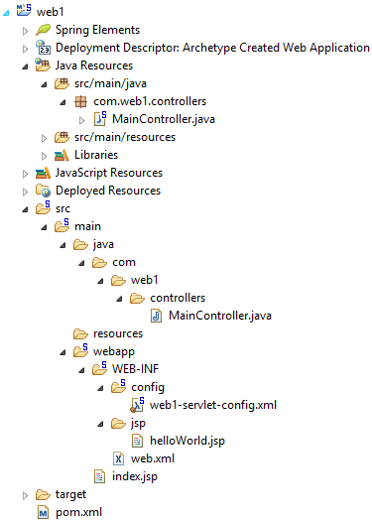
Spring MVC Application

